Slide 1
This is a presentation of introduction to linux . Learning the basics through an 8 course training

Slide 2
Week 2
The following three slides demonstrate basic file structure in linux

Slide 3
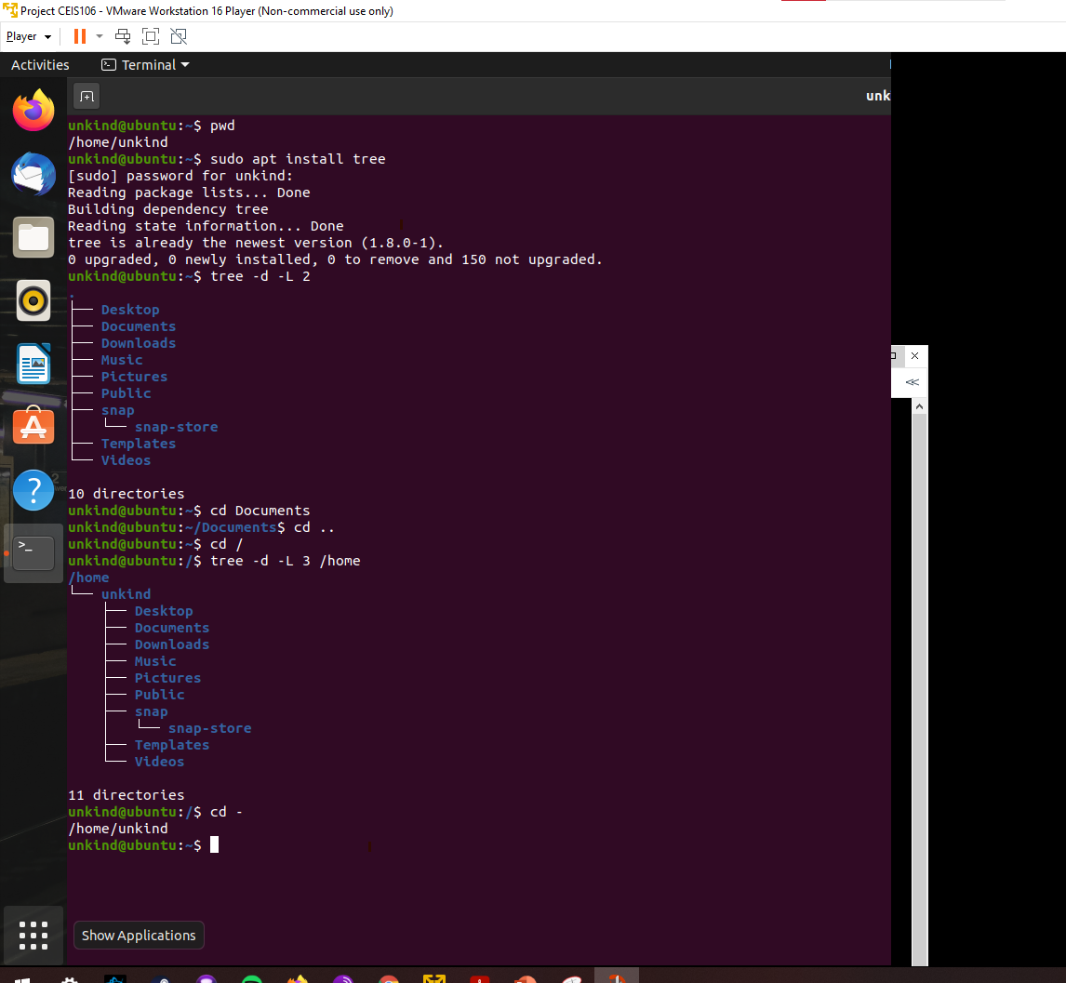
Create directories and files
Take a screen capture of the output in Steps 5 and 6.

Slide 4
Copy and remove directories and files
Take a screen capture of the output in Step 3.

Slide 5
Change script file permissions

Slide 6
The following slides will show what I learned in week 3

Slide 7
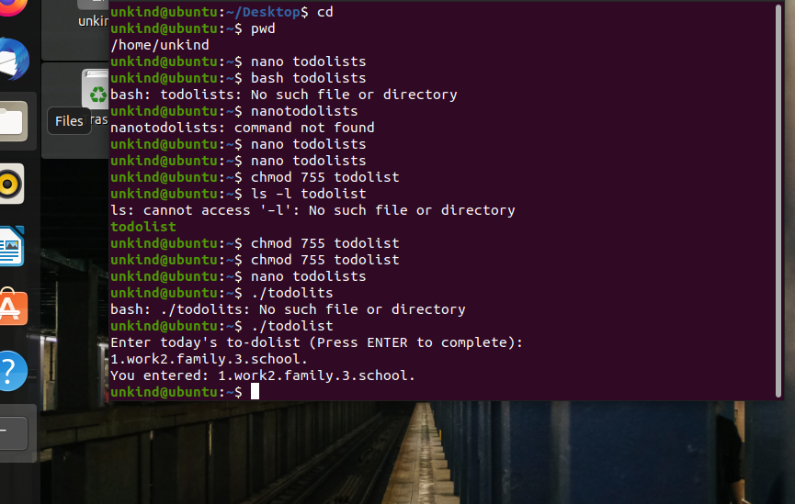

Slide 8
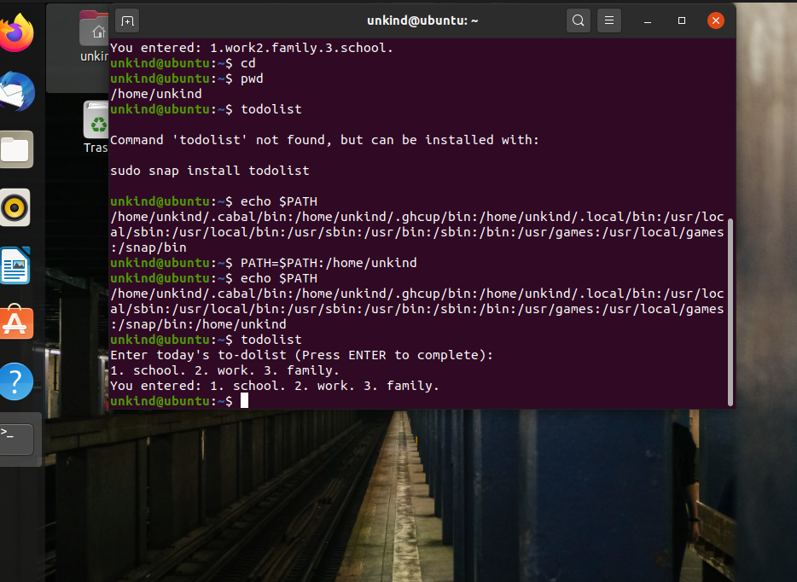
Set the path variable

Slide 9
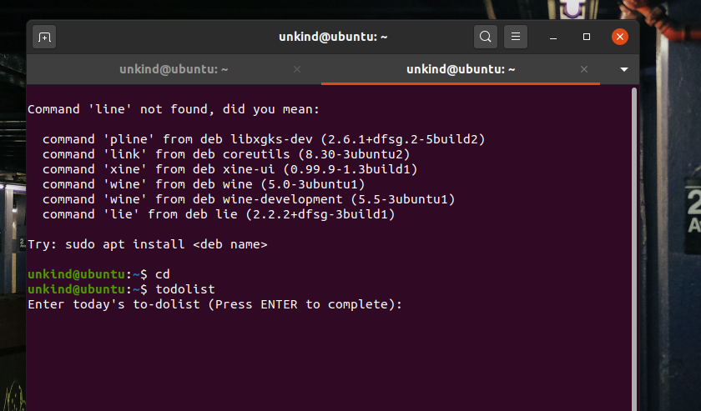
Make the PATH variable permanent

Slide 10
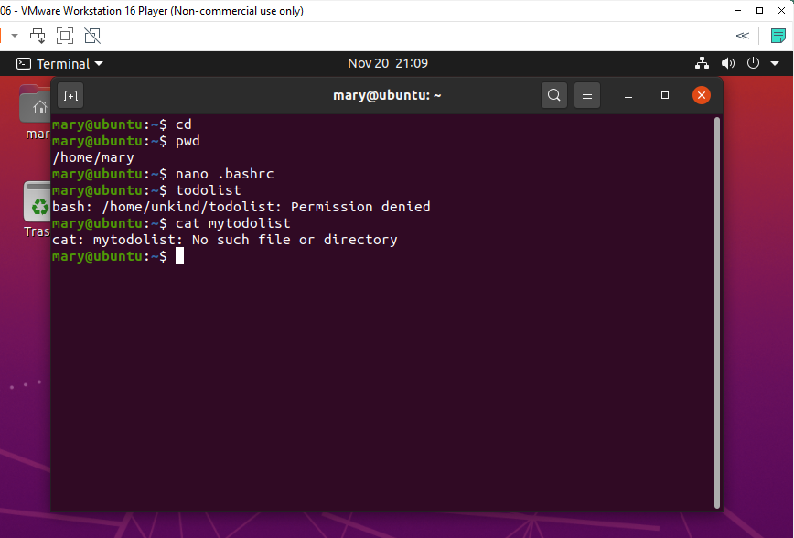
Week 4 Test user and group settings

Slide 11
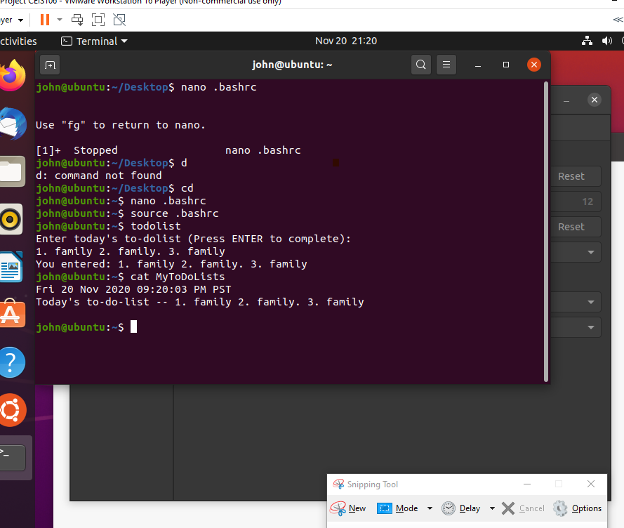
Add Users In Gui

Slide 12
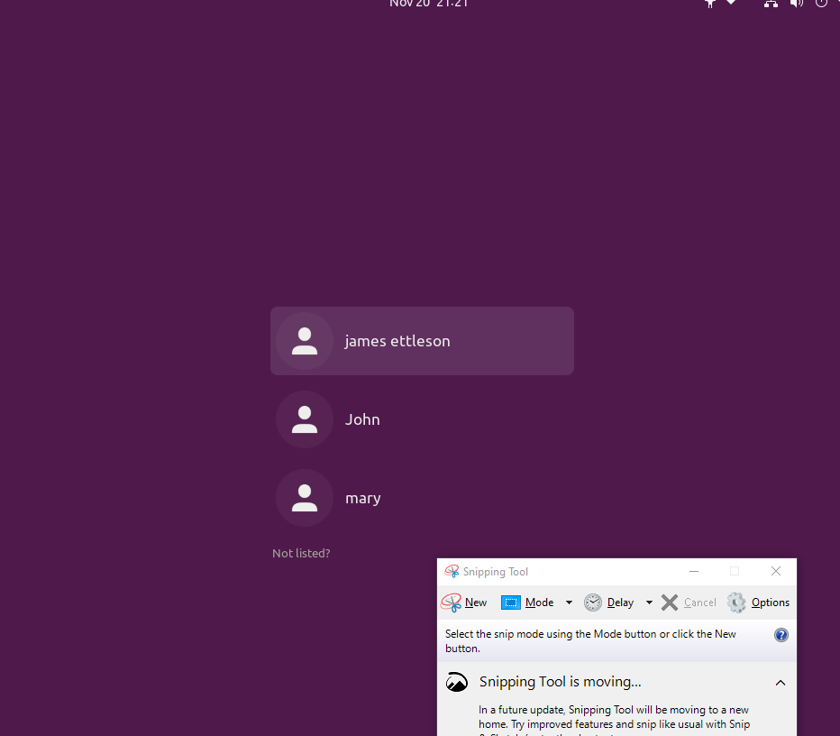
Remove users and groups

Slide 13
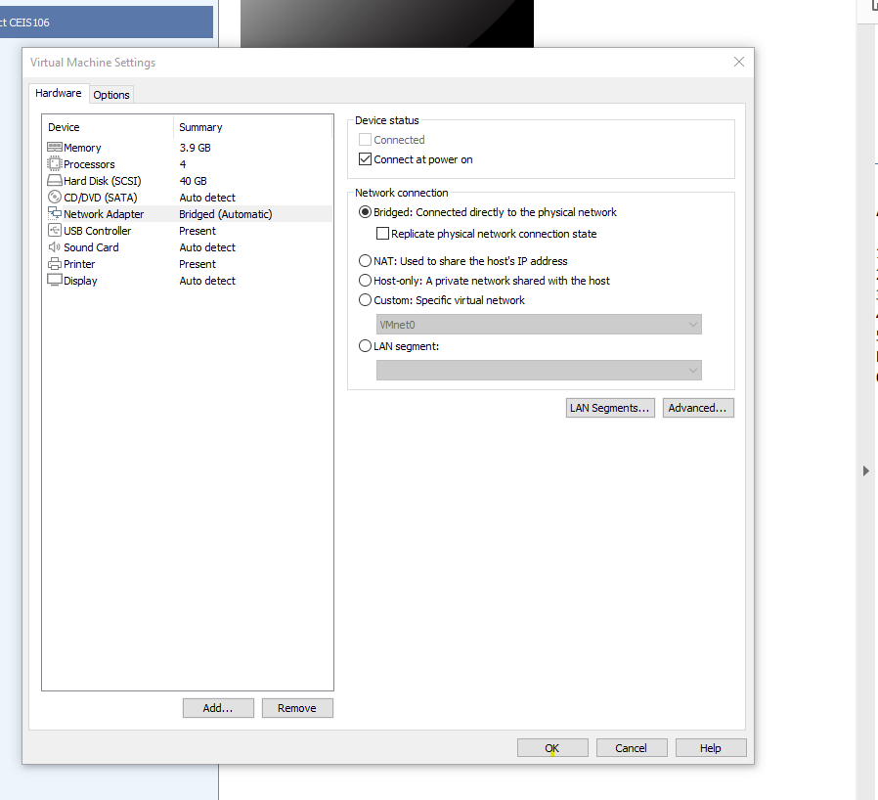
Connect the Ubuntu VM to the Internet

Slide 14
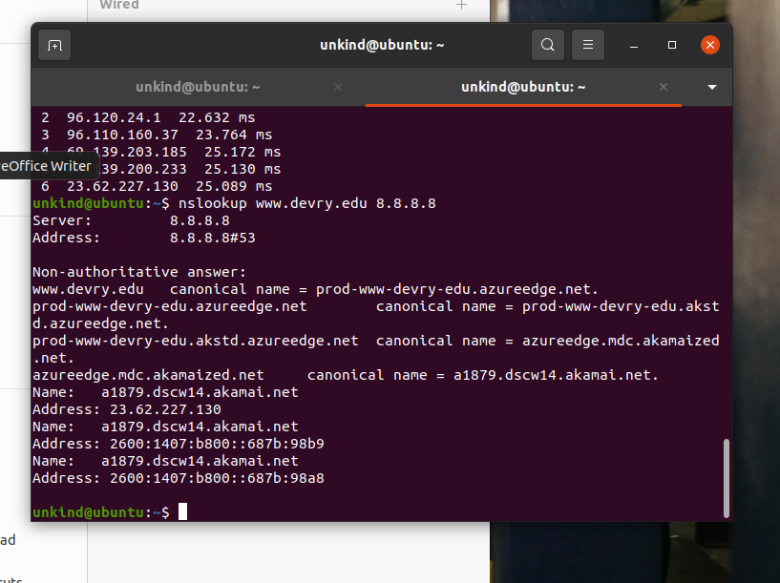
Use network utilities

